Slide 1
C-STORE OFFICE
ADVANCED ACCOUNTING – Customer Invoices

Slide 2
Agenda
Where do I go to create a customer invoice in C-Store?
Bill To: Creating an invoice
Ship To: Where is this merchandise going?
Completing a sales invoice

Slide 3
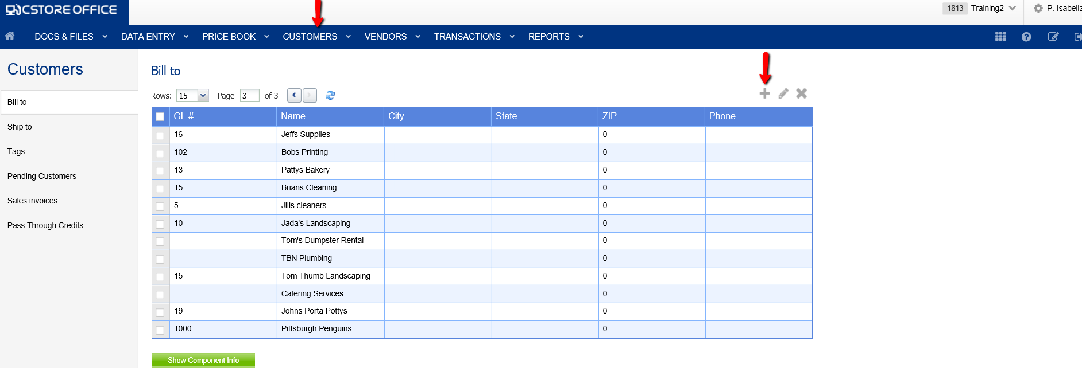
WHERE DO I GO TO CREATE A CUSTOMER INVOICE IN C-STORE?

Slide 4
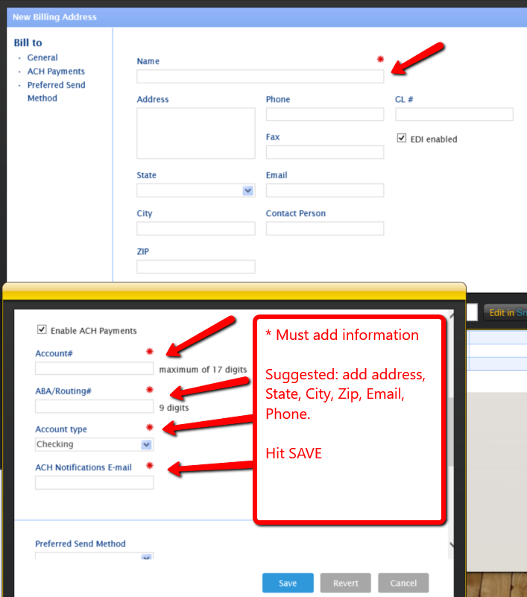
BILL TO: CREATING AN INVOICE

Slide 5
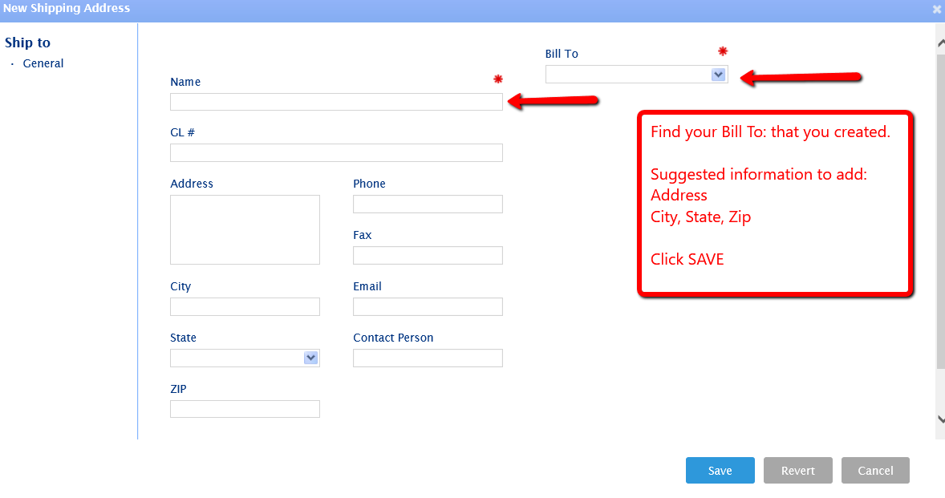
SHIP TO: WHERE IS THE MERCHANDISE GOING?

Slide 6
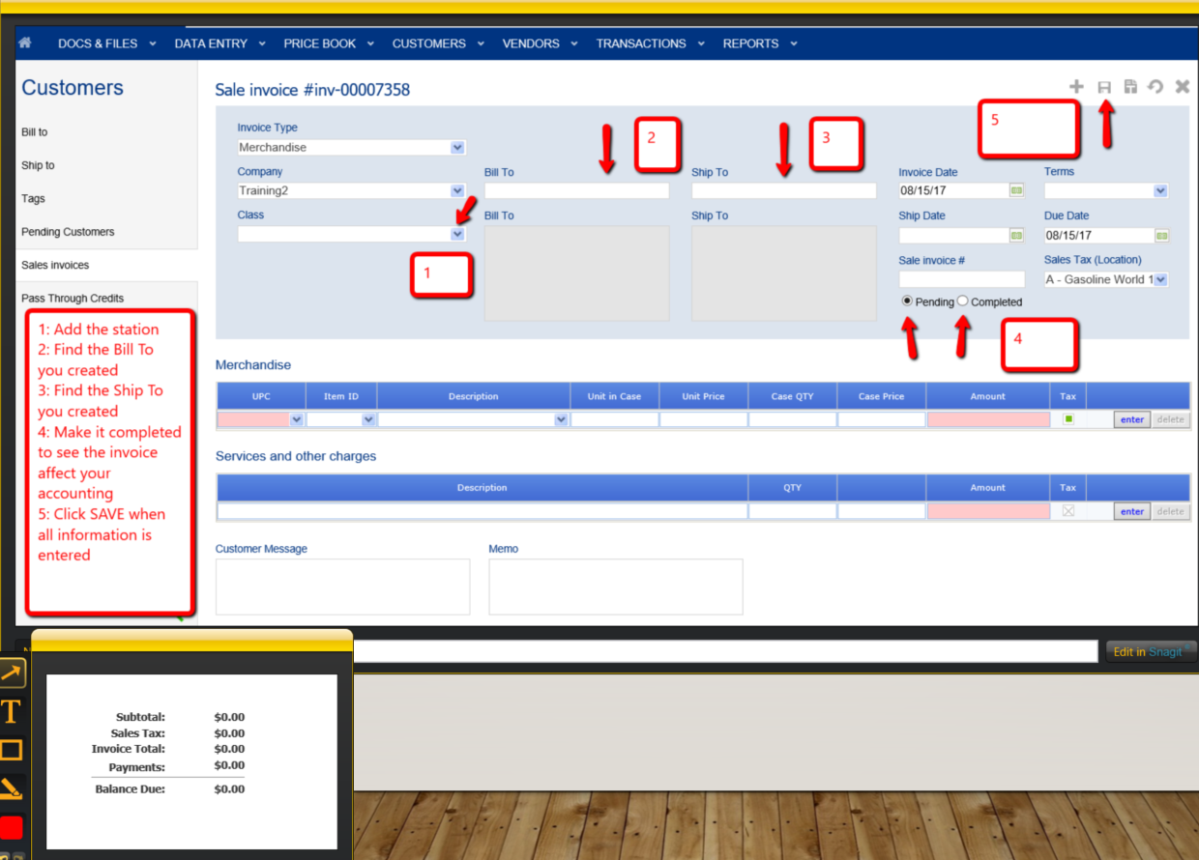
COMPLETING A SALES INVOICE

Slide 7
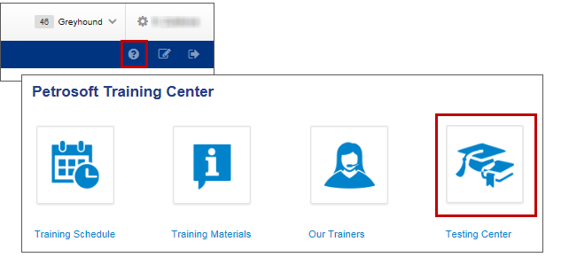
TRAINING CENTER
For additional testing on what you have learned, please refer to our new “Testing Center”.
To access this new feature, click the help icon, and then select Testing Center.

Slide 8
THANK YOU FOR YOUR TIME!
Get in Touch
www.cstoreoffice.com
Petrosoft LLC
290 Bilmar Drive
Pittsburgh, PA 15205
1.412.306.0640

